Slide 1

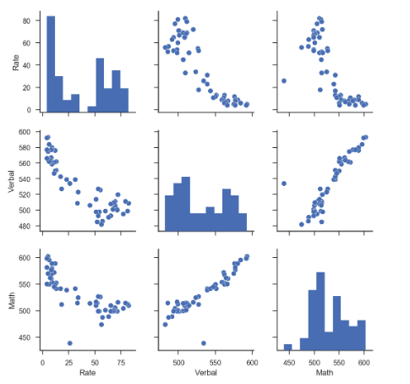
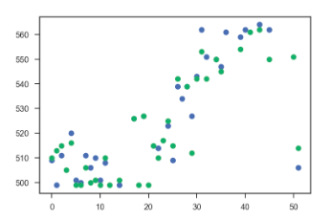
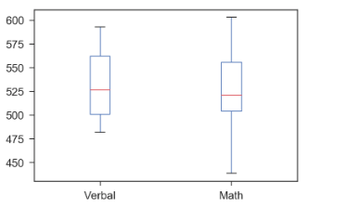
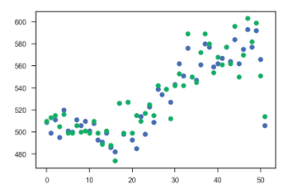
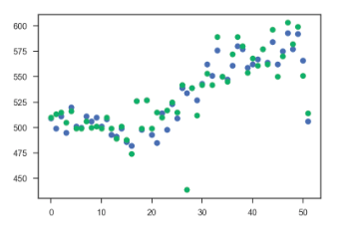
Sats Score
Sat Score : 52 rows, 3 Columns
: States, Verbal and Math
Pair Plot : positive correlation between Math and Verbal
Student who have high score in verbal probably will have high score in math and the opposite apply
What does this tell you about the distribution of Verbal scores?
24 State(46%)the mean, 26 state (50%) median
if the mean is lower than median, most student score above average, or >46%, the lower score is really low bring down the score, despite with student with higher score
68%(1 std)= outlier math 15, verbal 20
95%(2 std) = 1 math outlier
99.%(3std)

Slide 2
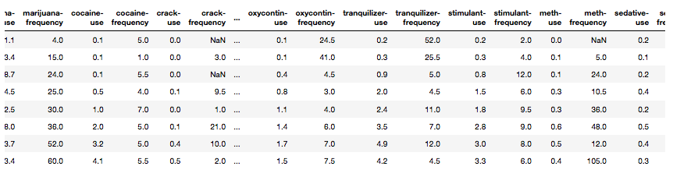

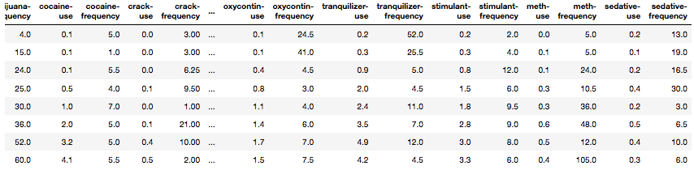
Drug Data
Drug data : 17 rows, 28 columns
:There are 9 missing data
Cleaning data:
Assumption: There must be missing data inside, using interpolate to replace null with some values
(Interpolation is an estimation of a value within two known values in a sequence of values)

Slide 3
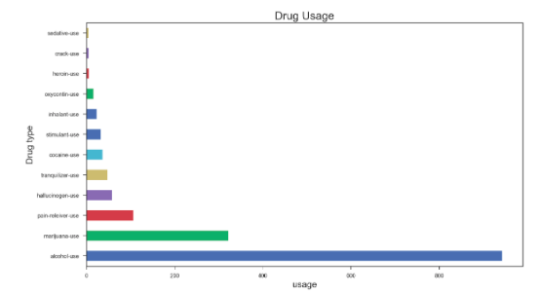
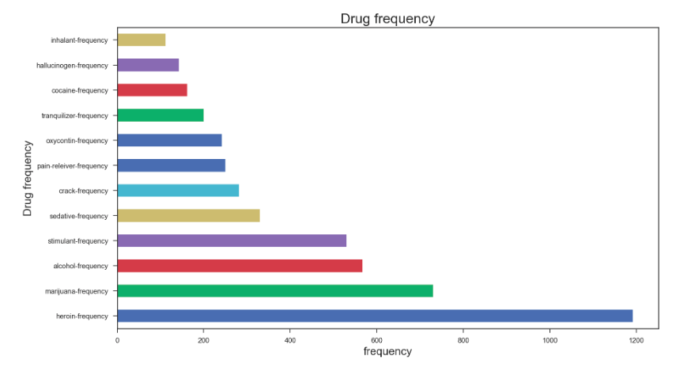
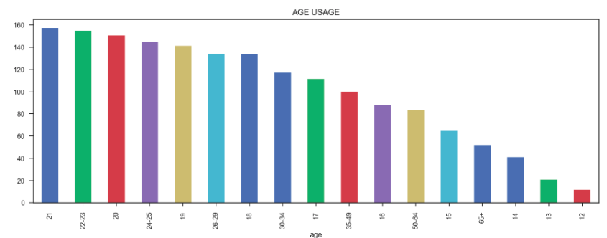
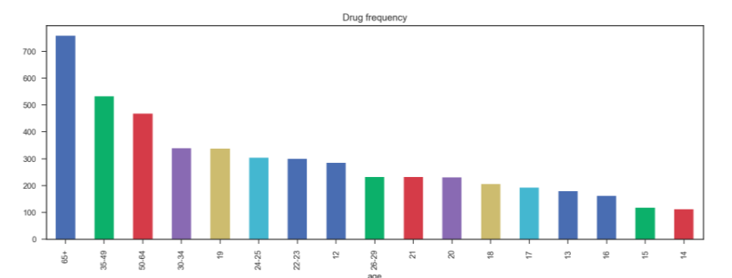


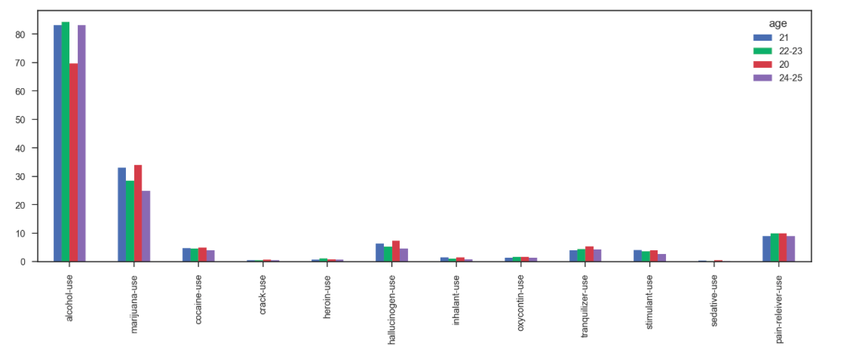
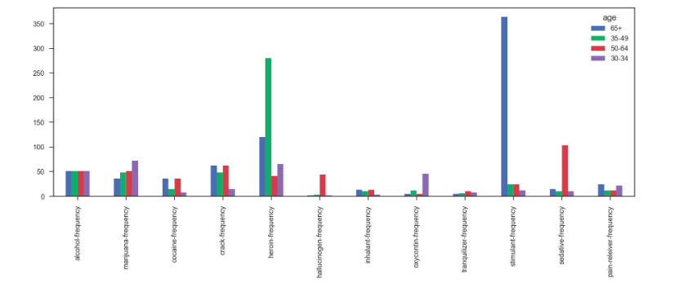
Drug Data
Alcohol use can be found in beer, wine even some food
Marijuana illegal sale all over the world despite of expensive price
sedative use fin anti anxiety drug that calm patient, permitting sleep
heroin use :relieve pain or in opioid replacement therapy
stimulant use :treat attention-deficit hyperactivity disorder (ADHD) and narcolepsy—uncontrollable episodes of deep sleep

Slide 4
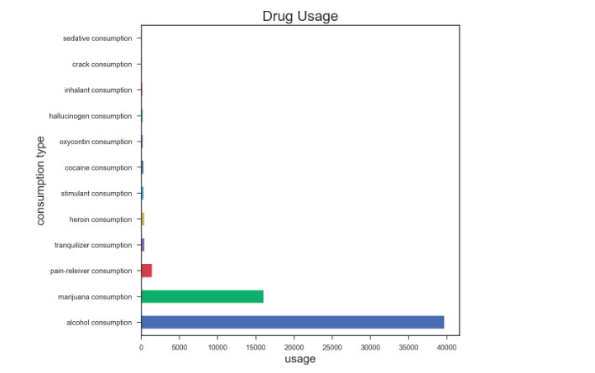
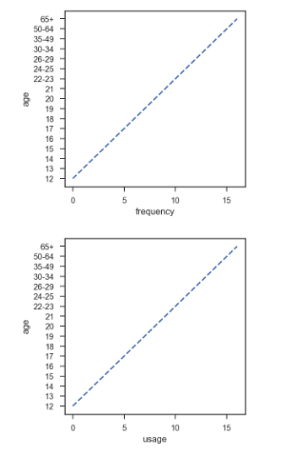
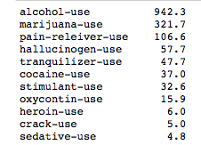
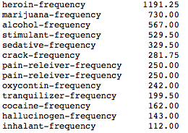
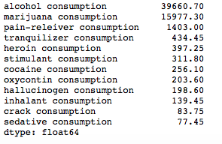
drug usage and frequency increase by age

Slide 5
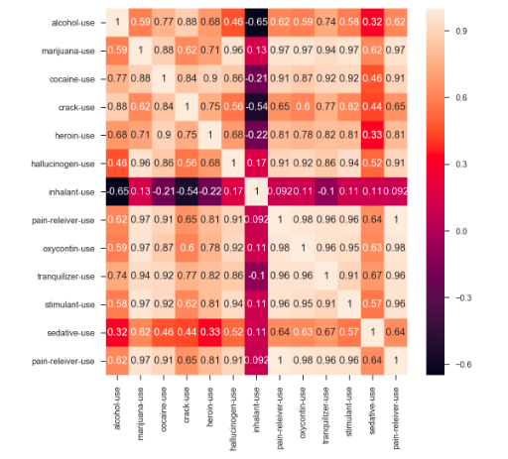
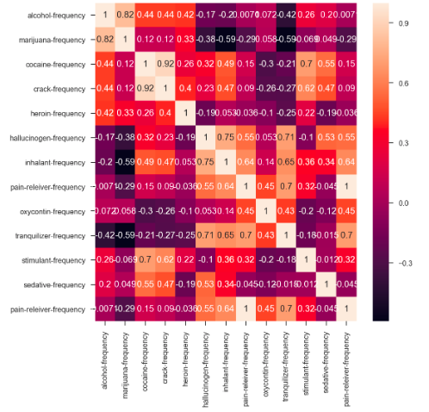
Correlation between drug use obvious the drug frequency

Slide 6
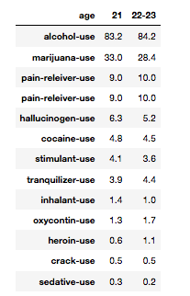
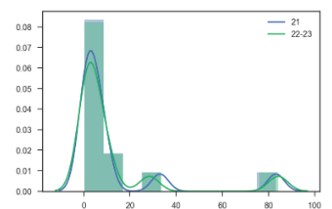
Hypotesis 1
Ho = there is no relation drug use in age 21 and 22-23
Ha = there is relation drug use in age 21 and 22-23
Using scipy.stats: t_stat = stats.ttest_ind(sample2, sample1,equal_var = False)
Scipy t-statistic: t = -0.02 p = 9.83e-01
Accept null hypothesis. There is no significant correlation between the dataset.

Slide 7
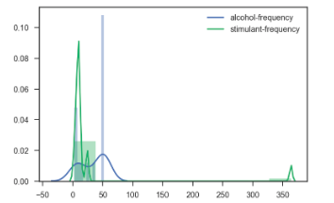
Hypotesis 2
mean value:
alcohol-frequency 33.352941
stimulant-frequency 31.147059
Ho: the characteristic behave the same way, there is no difference
Ha: they are not behave the same way
Using scipy.stats: t_stat = stats.ttest_ind(sample2, sample1,equal_var = False)
Scipy t-statistic: t = -0.10 p = 9.19e-01
Accept null hypothesis. There is no relation between alcohol and stimulant frequency

Slide 8
Drug Data
Next step :
1 To make drug data set in same level which is per age
2 Get remaining data up to 80+ years, to analyse further whether the frequency of drug use increase or decrease
Prediction that i wanted to clarify:
is the older you are you need to consume more drug to slow down the sickness and sustain longer life??
or
will they use less as they grow older

